Slide 1

Enhancing Search Engine Relevance for Video Subtitles
By: Sushmita Warvate & Shweta Shinde

Slide 2
Abstract:
In today's digital era, accessibility to video content stands as a paramount concern. Recognizing this need, our project endeavors to elevate the accessibility of video content by refining the search capabilities of subtitles, with a particular emphasis on the substance within them. Our goal is to craft an advanced search engine algorithm that adeptly retrieves subtitles in response to user queries, leveraging natural language processing and machine learning methodologies to bolster relevance and precision.
In contrast to conventional keyword-based search engines, which hinge on exact matches between user queries and indexed documents, we champion semantic search engines. These engines plumb the depths of understanding within queries and documents, delving into meaning and context rather than relying solely on keywords.
At the crux of our approach lie three pivotal stages: data preprocessing, vectorization of subtitle documents and user queries, and cosine similarity calculation. Data preprocessing entails meticulous cleaning steps, including removing timestamps to ensure thorough analysis. Vectorization serves to translate textual data into numerical representations, thereby facilitating comparison. Finally, cosine similarity calculation gauges the pertinence of documents to the user's query based on vector representations.
By harnessing the power of semantic search techniques, our project aspires to furnish more profound and pertinent search outcomes for video subtitles, thereby enriching the accessibility of subtitle content for all users.

Slide 3
1. Read the given data:
The provided data consists of a sample database titled "eng_subtitles_database.db," containing 82,498 subtitle files sourced from opensubtitles.org. These subtitles predominantly pertain to movies and TV series released between 1990 and 2024. The database is structured with a table named ‘zip files,' comprising three columns: 'num' for unique subtitle ID referencing opensubtitles.org, 'name' denoting the subtitle file name, and 'content' storing the compressed subtitle files in binary format using ‘Latin-1' encoding.
Each subtitle file's unique identifier ('num') can be utilized to retrieve further details from opensubtitles.org via the following link format: https://www.opensubtitles.org/en/subtitles/{num}. By substituting '{num}' with the respective unique subtitle ID, additional information about each subtitle file can be accessed directly.
In essence, the database serves as a comprehensive repository of subtitle files, offering researchers and developers access to a diverse collection of subtitles from various movies and TV series released over the past few decades, facilitating endeavors related to subtitle analysis, natural language processing, and accessibility enhancement in the realm of digital content consumption.

Slide 4
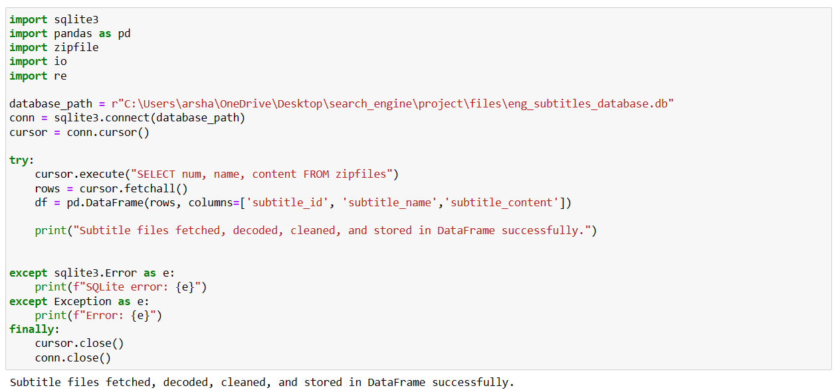
The Python script exemplifies the retrieval of subtitle data from an SQLite database, along with decoding, cleansing, and storing it in a Pandas DataFrame.
It establishes a connection to the SQLite database using SQLite3.connect (), with the database path specified as database_path.
A SQL query is executed to select data from the “zip files” table within the database, retrieving columns named “num”, “name”, and “content” for subtitle ID, name, and content respectively.
Utilizing the Pandas library, a DataFrame named df is generated from the fetched rows, comprising three columns: “subtitle_id”, “subtitle_name”, and “subtitle_content” representing the subtitle data from the database.
Upon successful completion of retrieval, decoding, cleaning, and storage of subtitle data in the DataFrame, a success message is printed.
Exception handling is incorporated to catch potential errors during script execution, encompassing SQLite errors (SQLite3.Error) and general exceptions (Exception).
Lastly, the SQLite cursor and connection are closed via the cursor. close() and conn.close() functions respectively, ensuring proper cleanup and release of database resources.

Slide 5
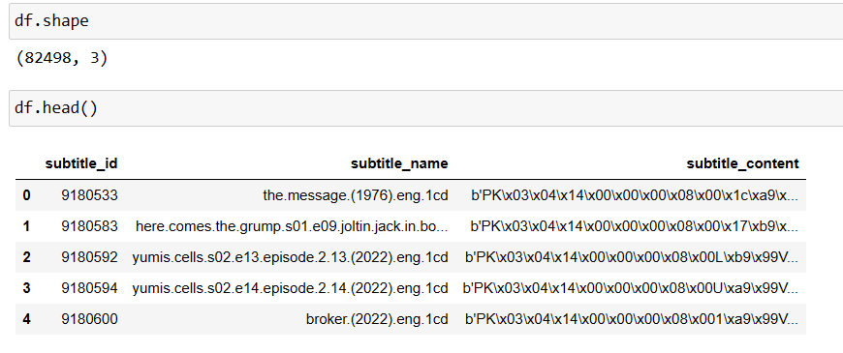
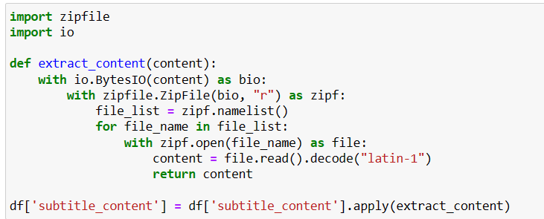
After fetching the data from the SQLite database and storing it in a Pandas DataFrame. The Data Frame df has 82,498 rows and 3 columns.subtitle_id: Represents the unique identifier for each subtitle.
subtitle_name: Contains the name or title of each subtitle file. subtitle_content: Holds the content or text of each subtitle. The subtitle_content column contains the binary content of the subtitle files, as indicated by the prefix 'b'. This content likely needs further processing or decoding to extract meaningful text information.

Slide 6
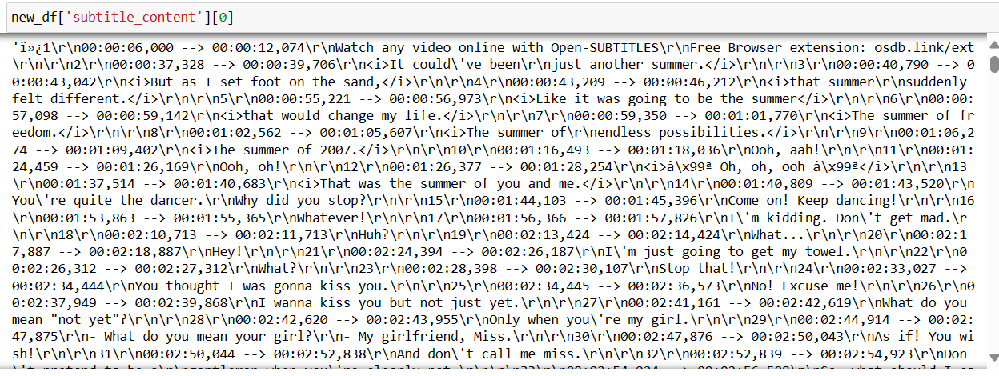
1(a). Unzipping the content and decoding using Latin-1 The extract_content function is defined with one parameter, content, representing the binary content of a zip archive containing subtitle files. The function utilizes the io.BytesIO class to create an in-memory binary stream (bio) from the provided content. Within the context of a zip file.ZipFile object (Zipf), created from the binary stream, the function iterates through the list of file names (file_list) contained in the zip archive. For each file in the archive, the function opens it (with Zipf. open(file_name) as file) and reads its content (content = file. read().decode("latin-1")). The content is decoded using the “Latin-1“ encoding, assuming it represents text data. The extracted content of the first file encountered in the zip archive is returned. Working with a Data Frame of shape (824925, 3) where one of the rows contains more than 100,000 tokens can consume a significant amount of computer resources, especially in terms of memory and processing power. Because of limited computing resources, only a random 30% of the data is used.

Slide 7
2. Cleaning:
Text data is subtitle content that has time stamps, HTML tags, and lots of noise. Cleaning has to be done on the text data, as cleaning text data is an essential preprocessing step in natural language processing (NLP) tasks, especially before vectorization.
1. The code defines a function clean_text(text) that applies several cleaning steps to the text data:
2. re. sub(r’\d{2}:\d{2}:\d{2},\d{3}→ \d{2}:\d{2}:\d{2},\d{3}\r\n’, ‘, text) This regular expression
removes timestamps in the format “hh:mm: ss, mmm→ hh:mm: ss, mmm” along with the carriage
return and newline characters (\r\n).
3. re. sub(r’\r\n’, ‘ ‘, text) This line replaces carriage return and newline characters (\r\n) with a space.
4. re. sub(r’<[^>]+>’, ‘, text) This regular expression removes HTML tags from the text. HTML tags.
5. re. sub(r’[^a-zA-Z\s]’, ‘, text) This line removes any characters that are not alphabetic or whitespace.
6. re. sub (r'\s+', ' ', text) This regular expression replaces multiple consecutive whitespace characters
with a single space.
7. text.strip() Finally, this line removes leading and trailing whitespace from the text.

Slide 8
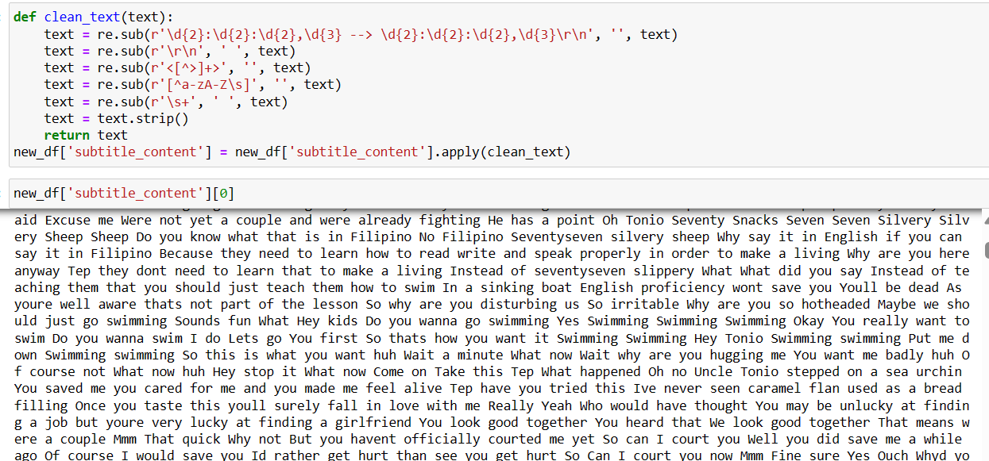

Slide 9
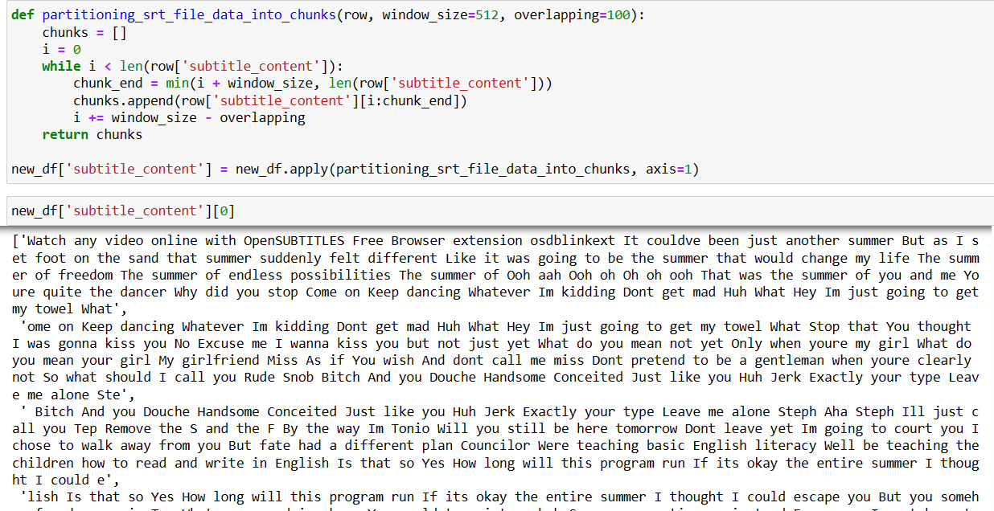
3. Document chunking:
As the text documents are very large, Considering the challenge of embedding large documents there will be Information Loss. The document chunking technique is used as a crucial step in handling large documents effectively, particularly in scenarios where embedding entire documents as single vectors is impractical due to the risk of information loss or computational constraints.

Slide 10
• Embedding entire long documents as single vectors can lead to information loss due to their diverse topics, sentiments, and themes, necessitating significant computational resources.
• Addresses this by dividing large documents into smaller, manageable chunks for individual processing and embedding, improving efficiency.
• Overlapping windows are used to prevent splitting important text between chunks. Chunks are based on a token window size, ensuring each contains just below a specified number of tokens, and overlaps to retain context between adjacent chunks.
4. Vectorize the given Subtitle Documents:
Bag-of-Words (BOW) and Term Frequency-Inverse Document Frequency (TF-IDF) are traditional methods for generating sparse vector representations of text data. While they are widely used and can be effective for certain tasks, they also have some disadvantages
4 (a). Disadvantages of BOW / TF-IDF:
No Semantic Information: BOW and TF-IDF representations do not capture semantic relationships between words or documents. They treat each word independently and ignore the context in which words appear. This can lead to limitations in capturing the true meaning or intent of the text. High Dimensionality: BOW and TF-IDF representations result in high-dimensional sparse vectors, especially for large vocabularies or datasets with many unique tokens. This high dimensionality can lead to computational inefficiencies and increased memory requirements. Given these disadvantages, using BOW or TF-IDF for text vectorization may not be ideal for tasks that require capturing semantic information or understanding the context of the text. Instead, for tasks like building a Semantic Search Engine, it's more beneficial to use methods that encode semantic information and capture contextual relationships between words and documents.

Slide 11
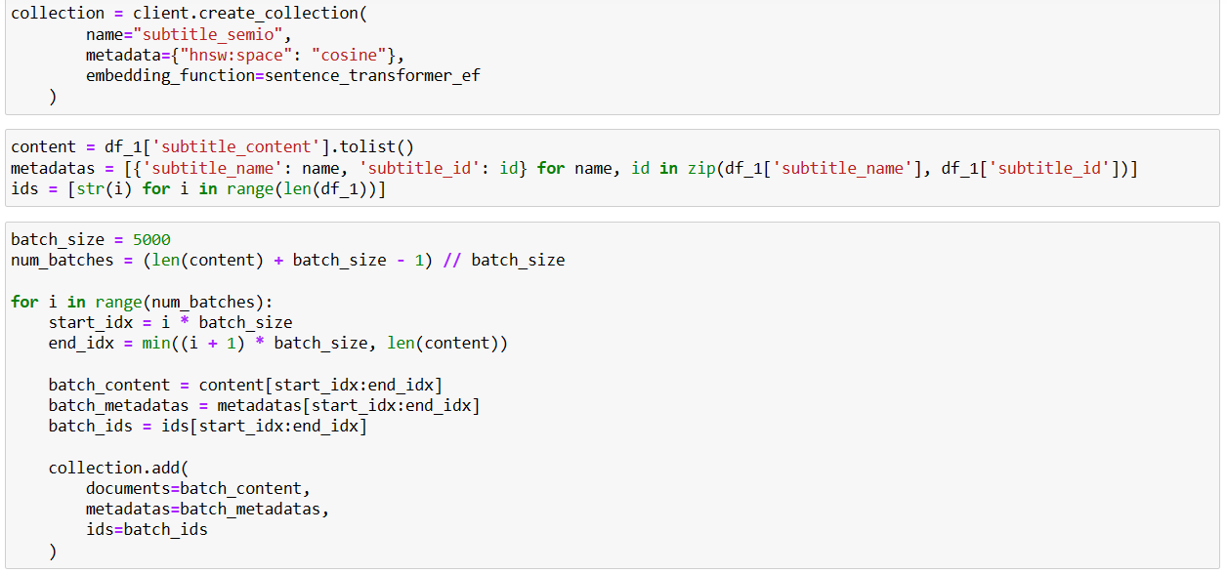
4 (b). Advantages:
• Semantic Information: BERT-based Sentence Transformers capture semantic relationships between words and sentences, allowing for a more nuanced understanding and interpretation of the text.
• Contextual Embeddings: Unlike BOW and TF-IDF, which treat each word independently, Sentence Transformers generate dense embeddings that take into account the context in which words appear.
• Lower Dimensionality: Dense embeddings produced by Sentence Transformers typically have lower dimensionality compared to sparse representations, reducing computational overhead and memory requirements.
• Pre-trained Models: Sentence Transformers leverage pre-trained models like BERT, which have been trained on large text corpora, capturing a wide range of linguistic patterns and semantic relationships.

Slide 12
5. Store embeddings in a ChromaDB database:
ChromaDB is used for storing text embeddings because of its specialized features and capabilities that make it well-suited for managing and querying high-dimensional embeddings efficiently. The process of creating and populating a collection in the Chroma DB database with embeddings generated using a Sentence Transformer model. Here’s a brief explanation of each step:
• Necessary libraries include Chromadb for interacting with the Chroma DB database, Sentence Transformer for generating sentence embeddings, and embedding_functions from Chromadb. utils for defining the embedding function.
• It initiates a persistent client for interacting with the ChromaDB database, specifying the path where the database will be saved.
• An embedding function named ‘sentence_transformer_ef’ is defined using the Sentence Transformer Embedding Function class from embedding_functions. This function utilizes a pre-trained Sentence Transformer model named "all-MiniLM-L6-v2" to generate embeddings for input sentences. "all-MiniLM-L6-v2" refers to a specific variant of the Mini LM model, which is optimized for speed, performance, and efficiency.
• A collection named "subtitle_sem" is created within the ChromaDB database. The collection is configured with metadata specifying the space as "cosine" to indicate cosine similarity for nearest neighbor search, and the defined embedding function sentence_transformer_ef is associated with the collection.
• The text content of subtitles (df_1['subtitle_content']) and corresponding metadata (df_1['subtitle_name'] and df_1['subtitle_id']) are retrieved from Data Frame df_1. The content and metadata are then split into batches for efficient insertion into the collection.
• The data is inserted into the collection in batches to avoid memory constraints and optimize performance. Each batch consists of a subset of the subtitle content, metadata, and unique IDs. The insertion process is repeated for each batch until all subtitle content, metadata, and IDs are processed.

Slide 13
6. Retrieving Documents
The process of retrieving documents based on a user's search query involves several key steps process of performing a semantic search using embeddings stored in a ChromaDB collection.
The user's search query is taken as input. In this case, the query text is “What happened last night when we were fully drunk".
While performing a query in the ChromaDB collection, query text is provided directly to ChromaDB, a defined embedding function sentence_transformer_ef is already associated with the collection, and ChromaDB internally uses the embedding function to generate embeddings for the query text.
ChromaDB then calculates the similarity scores between the query embedding and the embeddings of documents stored in the collection using a cosine distance as a similarity measure.
The cosine similarity scores are used to rank the candidate documents based on their relevance to the user’s search query. The code retrieves the top 10 most relevant documents from the collection, along with their corresponding distances (cosine similarity scores) and metadata.
The sorted list of candidate documents, along with their metadata (e.g., subtitle name), is printed to the console. The documents are sorted based on their cosine similarity scores in descending order, with the most relevant documents appearing first.
This approach allows you to leverage the pre-trained embedding model directly within ChromaDB, and simplifies the process of performing similarity searches without the need to generate embeddings externally.

Slide 14
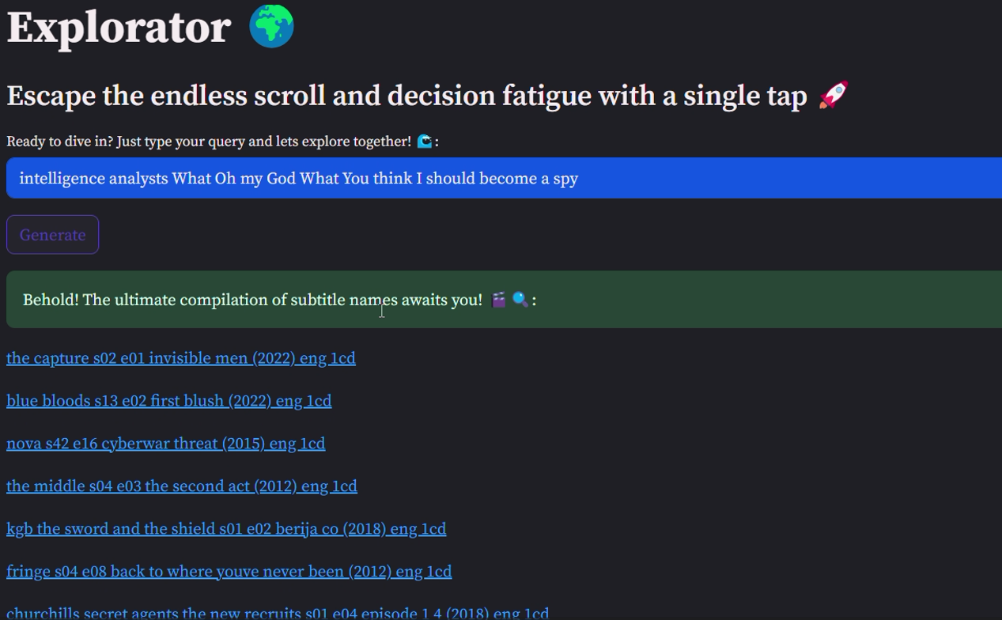
7. Retrieving Documents using user input Application:

Slide 15
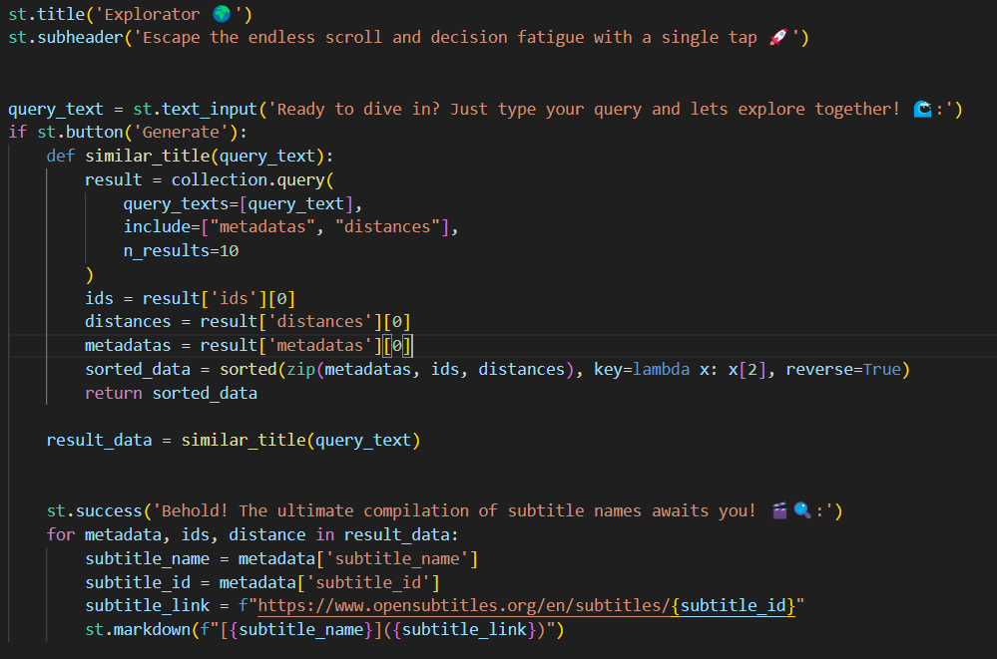
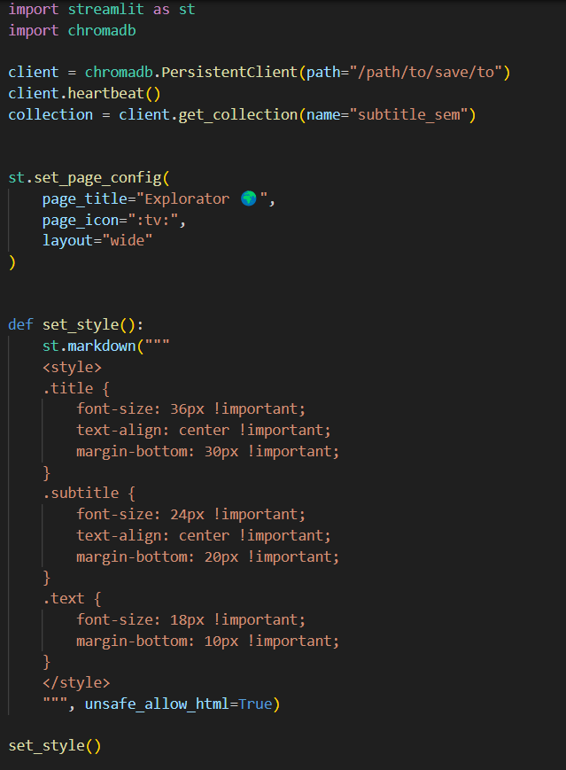
Backend application code:

Slide 16

8. Conclusion:
In conclusion, the documentation encompasses essential aspects of working with subtitle data, NLP models, and search engine development. It outlines techniques for retrieving and preprocessing subtitle data from an SQLite database, as well as extracting content from zip archives containing subtitle files. The choice of the "all-MiniLM-L6-v2" model for embedding generation is based on considerations of accuracy, speed, performance, model size, and compatibility. Additionally, the integration of NLP techniques into a search engine framework facilitates efficient information retrieval based on user queries. Overall, the documentation provides a comprehensive guide for developing NLP-based search systems tailored to subtitle data, enabling effective extraction of insights from text data in the context of video content

Slide 17

THANK YOU

